Slide 1
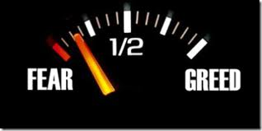
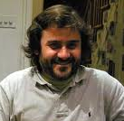
Agent’s fear monitors the spread of greed in a social network
EUMAS 2013
Toulouse
13th December, 2013
Nuno Magessi
GUESS/LabMag
Universidade Lisboa
nmagessi@campus.ul.pt
Luis Antunes
GUESS/LabMag
Universidade de Lisboa
xarax@di.fc.ul.pt
13/12/2013

Slide 2
Summary
Introduction
Social Interaction on tax evasion: review
Fear and greed working on
Greed fear interaction model
Results
Conclusions
13/12/2013

Slide 3
Introduction
How does fear interacts with greed under imitation in a social network?
What it is more important to monitor greed? Fear impact or greed awareness?
Why not to study this in a tax evasion context?
13/12/2013

Slide 4
Social Interaction on tax evasion: Review
Imitative behaviour in tax evasion Mittone et al. (2000)
Compliance with social behaviour of agents Davis et al. (2003)
EC* series includes imitation Antunes et al. (2006)
NACS Model Korobow et al. (2007)
TAXSIM Model Szabo et al. (2008)
Ising Model Zaklan et al. (2009)
13/12/2013

Slide 5
Fear working on
Induced by a threat
Causes Individuals retraction
Everything is done to omit from other individuals
Basic survival mechanism
Culture and past experiences affect fear generation
Fight or Flight response
Fear in human brain
The role of amygdala
The importance of learning
13/12/2013

Slide 6
What is greed?
Inordinate desire
Acquire and Possess more than one needs
Inability to control the ambition
Greed Purpose
Deprive others of potential means
Greed in human brain
High complexity mechanism
Interfere with brain reward system
Defense or counteraction from risk
13/12/2013

Slide 7
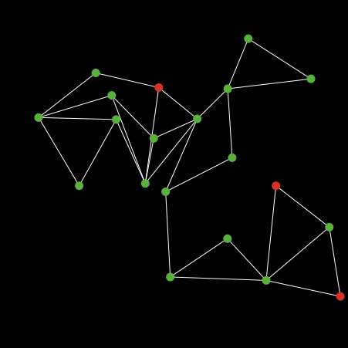
Greed-Fear Interaction Model
Each node represents a taxpayer
Each taxpayer could be:
Susceptible (green);
Greedy (red);
Resistant (gray);
Each greedy attempts to persuade neighbours
Nuno Trindade Magessi
Agent´s fear monitors the spread of greed in a social network
13/12/2013

Slide 8
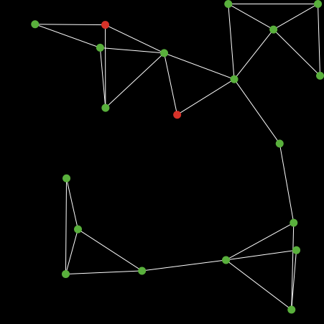
Greed-Fear Interaction Model
Susceptible taxpayers will imitate according a probability;
Resistant have fear and not imitate greedy taxpayer;
Greedy taxpayers are not always aware of greed.
When a taxpayer is audited, fear is stimulated
Nuno Trindade Magessi
Agent´s fear monitors the spread of greed in a social network
13/12/2013

Slide 9
Model Parameters
Greed Spread Chance is probability of imitation by susceptible taxpayers
Risk perception (awareness) frequency is the frequency of each greedy taxpayer become aware of his greed
Fear impact it is the probability of greed disappear in a short period of time
Risk averse chance is the probability of being resistant in new interactions given the fear impact
13/12/2013

Slide 10
Model Conditions
Conditions to spread greed
Taxpayers must hold greed;
Taxpayers must be linked to non resistants
Greed generated randomly < greed spread chance
Conditions to check greed
Taxpayer must have greed and awareness
Fear impact generated randomly < Fear impact parameter
Risk-averse-chance generated randomly < Risk-averse-chance parameter
13/12/2013

Slide 11
Output Results
Greed is never removed.
No risk aversion chance
Fear impact is 10%,
Greed spread is 5%
Risk awareness frequency is 20
Greed is never removed.
No risk aversion chance
No fear impact
No greed spread
Risk awareness frequency is 20
Nuno Trindade Magessi
Agent´s fear monitors the spread of greed in a social network
13/12/2013

Slide 12
Output Results
Greed removed.
No risk aversion chance
Fear impact is 5%,
Greed spread is 10%
Risk perception frequency is 1
Greed removed
No risk aversion chance
Fear impact is 10%,
Greed spread is 10%
Risk awareness frequency is 1
Nuno Trindade Magessi
Agent´s fear monitors the spread of greed in a social network
13/12/2013

Slide 13
Output Results
Greed never removed.
Risk aversion chance is 100%
No fear impact
Greed spread is 10%
Risk awareness frequency is 1
Greed removed.
No risk aversion chance
Fear impact is 1%,
No greed spread
Risk awareness frequency is 1
Nuno Trindade Magessi
Agent´s fear monitors the spread of greed in a social network
13/12/2013

Slide 14
Conclusions
Competition between fear and greed
Greed could remain forever in a social network
Fear is more important to monitor greed than awareness
Audits are important to stimulate fear and consequently minimizing tax evasion
Suggestion to Tax Authority: Pooling taxpayers by their social network
13/12/2013

Slide 15
Fear and Greed in a Social Network
MANY THANKS FOR YOUR ATTENTION
“The only thing we have to fear is fear itself.”
Franklin D. Roosevelt
“For greed all nature is too little.“
Lucius Annaeus Seneca
QUESTIONS - ISSUES - SUGGESTIONS
13/12/2013

