Slide 1
A Formal Model of Social Relations for Artificial Companions
Florian PECUNE – Magalie OCHS – Catherine PELACHAUD
CNRS – LTCI, Télécom Paristech

Slide 2
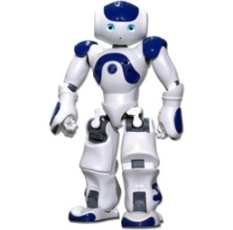
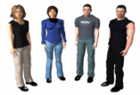
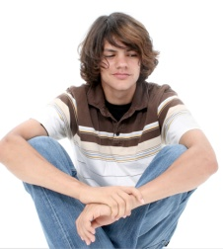
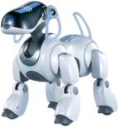
The MoCA Project
Create a “little world” of artificial companions…
“…a robot or a virtual conversational agent that possesses […] social skills that allow it to establish and maintain long-term relationships with users.” (Lim, 2012)
… with different roles and behavior
Focus on dyadic interactions

Slide 3
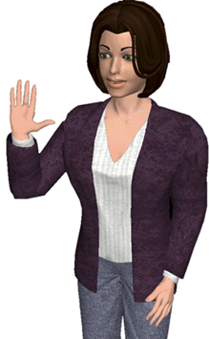
Thesis Objective
Create an agent able to make decisions according to its relation …
I do that because I like the user
… but also to influence user’s relation
I do that because I want the user to like me
Three research problematics:
How to represent social relations?
How do they change during interactions?
How to model the effects of these relations?

Slide 4
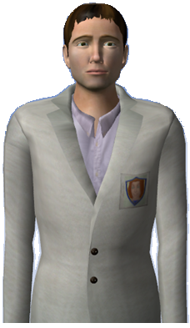
How to represent social relations? (1/2)
Ideal Social Relation
I would like to be more dominant than the user
Relation the agent would like to express
Influenced by agent’s role (Heise, 1987)
Expressed Social Relation
Felt Social Relation
Relation expressed by the agent
I like the user, I am less dominant than him
Influenced by felt and ideal relations (Scherer, 2005)
Intrinsic relation felt by the agent
Influenced by Mood (Isen & al., 1992)
Influenced by agent’s personality (Trapnell & Wiggins, 1990)

Slide 5
How to represent social relations? (1/2)
Ideal Social Relation
I would like to be more dominant than the user
Relation the agent would like to express
Influenced by agent’s role (Heise, 1987)
Expressed Social Relation
Felt Social Relation
Relation expressed by the agent
I like the user, I am less dominant than him
Influenced by felt and ideal relations (Scherer, 2005)
Intrinsic relation felt by the agent
Influenced by Mood (Isen & al., 1992)
Influenced by agent’s personality (Trapnell & Wiggins, 1990)

Slide 6
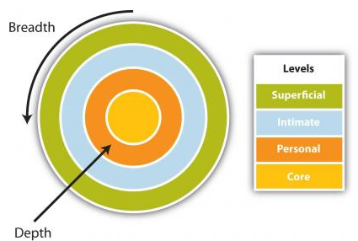
How to represent social relations? (2/2)
Several dimensions used to define social relations
Dominance and liking are the most widely used (Argyle, 1988)
Dominant
Familiarity useful for long-term relationship (Bickmore & Picard, 2005)
Disliking
Liking
Dominance
Submissive
“the capacity of one agent to affect the behavior of another” (Prada & Paiva, 2008)
Liking
“A general and enduring positive or negative feeling about some person” (Moshkina & Arkin, 2003)
Familiarity
“mutual knowledge of personal information” (Svennevig, 1999)
(Altman & Taylor, 1973)

Slide 7
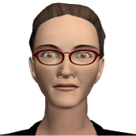
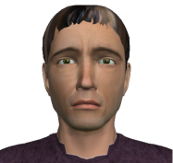
Dominance – The dependence (1/3)
Dependence of an agent A upon an agent B (Emerson, 1962)
“Directly proportional to A's motivational investment in goals mediated by B (…)
(…) Inversely proportional to the availability of those goals to A outside of the A-B relation”
I can bring you
there with my car.
I really want to go to
the concert tonight !
I can bring you
there with my car.
Maybe I could go to
the concert tonight.
Agent B
Agent A
Agent B
Agent A
High Dependence
Low Dependence
I can bring you
there with my car.
I really want to go to
the concert tonight !
I’m the only one who
can bring you there.
I really want to go to
the concert tonight !
We can bring you there too !
Agent B
Agent A
Agent B
Agent A

Slide 8
Dominance – The dependence (2/3)
An agent i can be helpful ….
I can bring you
there with my car.
I really want to go to
the concert tonight !
If j has an intention
And i can do an action a after what will be true
Agent B
Agent A
… or threatening
Not if I cancel the
concert !
I really want to go to
the concert tonight !
If j has an intention
Agent B
Agent A
And i can do an action a after what it will be impossible to achieve
Or i can do an action a’ cancelling a precondition of

Slide 9
Dominance – The dependence (3/3)
j is dependant upon i toward an intention
means that j believes
i can help j to achieve this intention
and
j can not achieve this intention himself
or
i can prevent j to achieve this intention

Slide 10
Dominance – The dependence value (1/2)
Dependence influenced by the importance accorded to intentions…
Importance accorded by i to the success of an intention
Importance accorded by i to the non failure of an intention
It is normal to be
understood by the user
It is not normal if the user do not understand me !
Low importance of success
High importance of failure
Agent A
Agent A
… and the number of potential helpers
Number of agents susceptible to have a positive impact on the intention
The number of potential threatening agents is not taken into account

Slide 11
Dominance – The dependence value (2/2)
Dependence value
Positively influenced by the importance accorded to the intention (success or non failure)
Negatively influenced by the number of potential helpers
I can bring you
there with my car.
I really want to go to
the concert tonight !
I can destroy your
TV !
I don’t care that much
Agent B
Agent A
Agent B
Agent A
High importance
Low number
Low importance
High Dependence
Low Dependence

Slide 12
Dominance – Dominance value
The dominance value of an agent i toward another agent j is :
i dominance toward j
B_{i}(j dependence upon i)
B_{i}(i dependence upon j)
The difference between his belief about j’s dependence upon him and his believed dependence upon j
The agent i is dominant toward j if he believes he is less dependant upon j than j is upon him
I can bring you
there with my car.
I really want to go to
the concert tonight !
I don’t care that
much…
I can destroy your TV!
Agent B
Agent A
Agent B
Agent A
High Dependence
Low Dependence
B is dominant

Slide 13
Dominance – Strategies (1/2)
To improve his level of dominance, an agent i can :
Decrease the importance accorded to one of his intentions that the agent j may achieve or threaten
Decrease his dependency by finding other sources able to help him
I can bring you
there with my car.
Finally, I don’t care…
I can bring you
there with my car.
I really want to go to
the concert tonight !
Agent B
Agent A
Low importance
Low number
Agent B
Agent A
I really want to go to
the concert tonight !
I can bring you
there with my car.
High importance
Low number
We can bring you there too !
Agent B
Agent A
High importance
High number

Slide 14
Dominance – Strategies (2/2)
To improve his level of dominance, an agent i can :
Try to increase the motivational investment of the other agent
Deny alternative sources for the other agent
i dominance toward j
B_{i}(j dependence upon i)
B_{i}(i dependence upon j)
Find other intentions for which he can be helpful
Find other intentions for which he can be threatening

Slide 15
How to represent social relations? (2/2)
Several dimensions used to define social relations
Dominance and liking are the most widely used (Argyle, 1988)
Dominant
Familiarity useful for long-term relationship (Bickmore & Picard, 2005)
Disliking
Liking
Dominance
Submissive
“the capacity of one agent to affect the behavior of another” (Prada & Paiva, 2008)
Liking
“A general and enduring positive or negative feeling about some person” (Moshkina & Arkin, 2003)
Familiarity
“mutual knowledge of personal information” (Svennevig, 1999)
(Altman & Taylor, 1973)

Slide 16
Liking – Theory
Based on Heider’s Balance Theory(Heider, 1958)
Concept X
Agent B
Agent A
Concept
A relation is balanced :
I like chocolate.
Me too !
“If all three relations are positive in all respects (…)
(….) or if two are negative and one positive.”
Agent B
Agent A
I don’t like bravery.
Concept
I do.
People tend to seek balanced states (Zajonc, 1960)
Sharing appreciations will improve the liking
Agent B
Agent A

Slide 17
Liking – Appreciation
The agent i appreciate the concept X
Shared appreciation
Concept
I like chocolate.
Me too !
Agent B
Agent A
Contradictory appreciation
I don’t like bravery.
Concept
I do.
Agent B
Agent A

Slide 18
Liking – Liking value
Importance accorded to a concept X
Concept
Concept
I like chocolate.
Me too !
I don’t like bravery.
I do.
Agent B
Agent A
Agent B
Agent A
Low liking
High disliking
Liking value of an agent i toward an agent j :
i liking toward j
Importance accorded to shared concepts
Importance accorded to contradictory concepts

Slide 19
Liking – Strategies
To improve his level of liking, an agent i can :
Change its own appreciation about a concept for which j has a different feeling
Try to change j’s feeling about this same concept
I like football.
Concept
Me too.
I don’t like football.
Concept
I do.
Agent B
Agent A
Agent B
Agent A
I don’t like football.
Concept
Me neither.
Unbalanced
Agent B
Agent A

Slide 20
How to represent social relations? (2/2)
Several dimensions used to define social relations
Dominance and liking are the most widely used (Argyle, 1988)
Dominant
Familiarity useful for long-term relationship (Bickmore & Picard, 2005)
Disliking
Liking
Dominance
Submissive
“the capacity of one agent to affect the behavior of another” (Prada & Paiva, 2008)
Liking
“A general and enduring positive or negative feeling about some person” (Moshkina & Arkin, 2003)
Familiarity
“mutual knowledge of personal information” (Svennevig, 1999)
(Altman & Taylor, 1973)

Slide 21
Familiarity – Theory
Based on Social Penetration Theory(Altman & Taylor, 1973)
Breadth represents the number of topics shared by the agents
Depth represents the intimacy value accorded to a topic
Family
Superficial
Intimate
Personal
Work
Religion
Core
Politics
Love

Slide 22
Familiarity – Theory
Breadth
Ratio between the number of i’s beliefs about j’s feelings and the number of possible conversational topics
Family
Except for love, I talked with j
about everything I would like to know
Superficial
Intimate
Personal
Work
Religion
Core
High Breadth
Agent A
Politics
Love

Slide 23
Familiarity – Theory
Depth
Intimacy value accorded to a concept X
Mean value of Intimacy
Family
Superficial
Intimate
Personal
Work
Religion
Core
Low Depth
Politics
Love

Slide 24
Familiarity – Strategies
To improve his level of familiarity, an agent i can :
Improve breadth by asking information about topics for which he does not have any beliefs
Let’s talk about Love !
Agent A
Improve depth by asking more intimate information about a particular topic
Tell me more about
your family.
Agent A

Slide 25
Future Work
Define scenarios to test this model
Formalize influence of personality on social relations
Implement a neural network to represent the
dynamics of the relations
Formalize ideal and expressed social relations

Slide 26
A Formal Model of Social Relations for Artificial Companions
Florian PECUNE – Magalie OCHS – Catherine PELACHAUD
CNRS – LTCI, Télécom Paristech

Slide 27
Logical Framework
Mental attitudes
The agent i believes that is true
The agent i has the intention and actively desires to achieve it
Operators
The action a might happen and will be true after that
can not be true if is not already true
The agent i can be the author of the action a

